Slide 1
Database Design Fundamentals
DV6E 34

Slide 2
Topics/Outline
Database – Definition, Types, Terminologies, concepts, classes & examples
Flat Files
Relational Database Management System (RDBMS)
E-R Model Systems
Normalisation
SQL – Introduction, queries,
Creating Database (simple - excel & structured - RDMS)
Basic Operations (DB interrogation, data acquisition, modification, normalisation, manipulation….)

Slide 3
Part. E: Normalisation

Slide 4
What is Normalisation?
The process of converting complex data structure or forms to simple entities before they can be implemented in a database is called – Normalisation
Normalization split a large table into smaller tables and define relationships between them to increases the clarity in organizing data.
It is a systematic approach of decomposing database tables to eliminate data redundancy and undesirable anomalies to improve data organisation, accessibility and operational efficiency.
It involves a multi-step process that puts data into tabular form by removing duplicated data from the relation tables
The end result of normalisation is a set of entities produced after decomposing complex data to remove unnecessary redundancy (i.e. duplication of data).

Slide 5
Why Need for Normalisation?
Normalisation is required to ensure that data structures or forms are presented in such a way that the data can easily be implemented in a relational database.
Normalization increases the clarity in organizing data in Database.
If the data appears or presented in a Simple Structure, then there will be no need for normalisation
Another reason for normalisation is to organise data fields to achieve the most efficient and flexible way to store and access data
A Complex Structure is not easily setup in a relational database, the complex entity must first be converted to Simple entities before they can be implemented in the database
The ultimate goal of normalisation is to reduce the data in a database to its simplest structure (or form) and to minimise redundancy of data.
Note
Data Redundancy means when same data is represented multiple times in the file

Slide 6
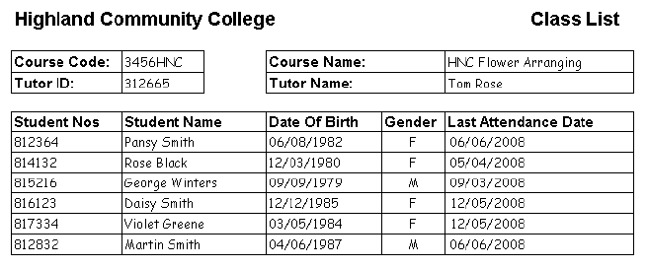
Complex Entities
Complex entities refer to data structures containing repeated data or entities with more than one entry.
Complex entities will need to be converted into simple forms before they can be used more efficiently in setting up an efficient database.
From the college school record shown above, you will notice that certain data repeats more than once (Student Nos, Student Name, Date of Birth, Gender and Last Attendance Date).
This is, therefore, a complex entity since different courses will have different numbers of students.
The structure needs to be converted into its simple form (i.e. normal forms) before it can be used efficiently within the database.

Slide 7
Complex Entities - Example
For the college school record shown above, you will notice that certain data repeats more than once (Student Nos, Student Name, Date of Birth, Gender and Last Attendance Date).
This is, therefore, a complex entity since different courses will have different numbers of students.
The structure needs to be converted into its simple form (i.e. normal forms) before it can be used efficiently within the database.

Slide 8
Normal Forms
This refer to the simple structure form that data must be converted to from complex entities for easy and more efficient use by database.
Conversion of data structures into simple structures (i.e. Normal Forms – NF) is usually done in stages.
Basically the normal form of the data indicates how much redundancy is in that data or database
Stages of Normalisation
Stages of Normalisation are as follows;
Un-normalised form – UNF
First normal form – 1NF
Second normal form – 2NF
Third normal form – 3NF
Boyce – Codd Normal Forms - BCNF
Note:
The BCNF is a specialised form of normalisation proposed by Boyce Codd.

Slide 9
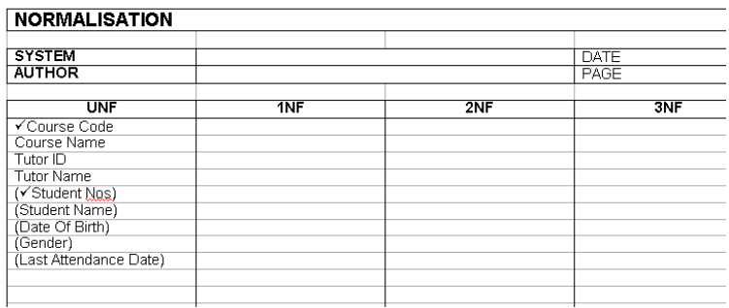
Un-Normalised Form (UNF)
To produce the Un-Normalised Form (UNF) of an entity we must carry out the following;
list the attributes of the entity
identify the main key
identity the repeating group of attributes
identify its key
Example
From table below the keys are shown by a tick (√) and the repeating group of attributes is shown bracketed.

Slide 10
Un-Normalised Form (UNF) - Example
From table below the keys are shown by a tick (√) and the repeating group of attributes is shown bracketed.

Slide 11
1st Normal Form (1NF)
The first normal form (1NF) deals with the ‘shape’ of the record type.
To be in 1NF, all occurrences of the record type must have the same number of fields, i.e. exactly the same number of attributes. As each ‘field’ can only hold a single value.
A relation is said to be in 1NF if, and only if, it contains no repeating attributes or groups of attributes.
Note
1NF excludes - variable repeating fields and groups.

Slide 12
Converting To 1st Normal Form (1NF)
To convert the entity to first normal form (1NF) we must:
Remove the repeating group of attributes to form a new entity
To remove the repeating group, either: (i) flatten the table and extend the key or (ii) decompose the relation-leading to 1NF.
Add to it the original key from the non-repeating attributes.
From the previous example table, the rules above can be applied using the following facts:
The original key is Course Code
The repeating fields are:
Student Nos
Student Name
Date Of Birth
Gender, and
Last Attendance Date..
Note:
By applying the rules we would produce two tables (at this stage usually called entities).
These two separate tables are still related. This relationship is through the Course code.

Slide 13
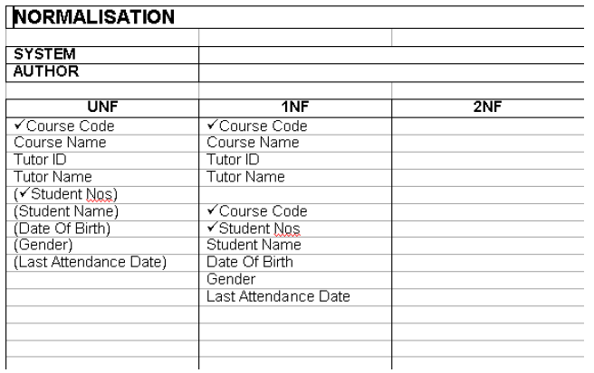
Converting To 1st Normal Form (1NF) - Example
Normalising the table to 1NF:
Each entity has been flattened, i.e. the attributes will only hold one value.
The new table (i.e. 1NF) now consist of two entities linked by the Course Code key.
This means that each student in the class is represented by an entry in the second table so now there is no problem with having increasing numbers of students

Slide 14
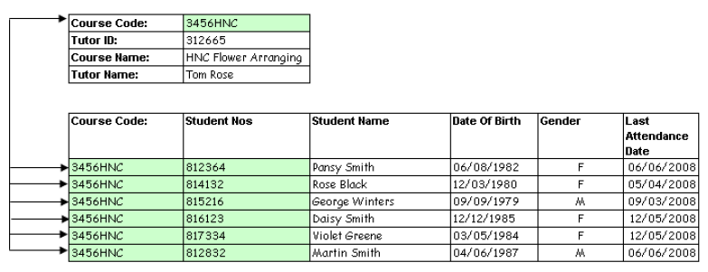
Converting To 1st Normal Form (1NF)
From the normalised table above, we now have two entities linked by the Course code key.
This means that each student in the class is represented by an entry in the second table so now there is no problem with varying numbers of students.
At this stage you can ‘visualise the data’ to check than no data has been lost.
If we look at the first record in the Student Nos entity it is unique because there is only one occurrence of a record containing a course code of 3456HNC and student number 812364.

Slide 15
1st Normal Form (1NF) – Summary
A relation is in 1NF if it contains no repeating groups
To convert an unnormalised relation to 1NF either:
Flatten the table and change the primary key, or
Decompose the relation into smaller relations, one for the repeating groups and one for the non-repeating groups.
Remember to put the primary key from the original relation into both new relations.
This option will possibly give the best results.
Example
Given:
R(a, b, (c, d))
To 1NF will become …
R(a, b)
R1(a, c, d)

Slide 16
2nd Normal Form (2NF)
A relation is in 2NF if, and only if, it contains no repeating attribute or groups of attributes, and every non-key attribute is fully functionally dependent on the whole key.
If a relation is in 1NF and has a single attribute key, it must automatically already be in 2NF.
Generally, 2NF is more stringent normal form compared to 1NF.

Slide 17

Converting To 2nd Normal Form (2NF) - Example
Example: Consider previous student records table;
From the example above, we now have three tables in our database for the 2NF.

Slide 18
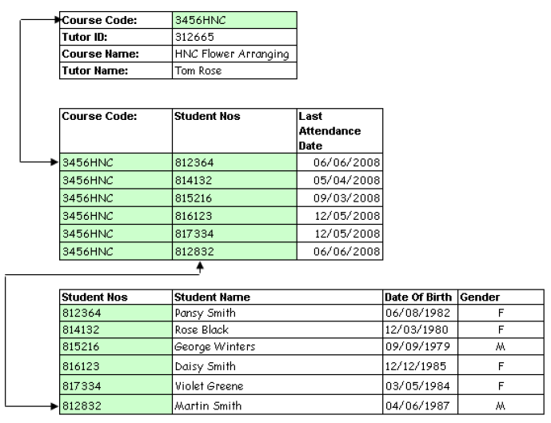
Converting To 2nd Normal Form (2NF)

Slide 19
Converting To 2nd Normal Form (2NF)
From Example of Normalised 2NF Table (previous slide)
The 2NF normalised form now has 3 tables in the database which are linked or related.
This check provides evidence that the 2NF relationships work.
For example, the query “What was the last date of attendance for student 816123 on the course HNC Flower Arranging?” can still be answered since we can relate the three tables.
Note:
At any stage of the process of normalisation we can check to see if the relationships between the data are still valid.
At no stage should an entity exist in isolation, that is to say, an entity must always have links to the others at the same stage of the process.

Slide 20
2nd Normal Form (2NF) – Summary
A relation is in 2NF if it contains no repeating groups and no partial key functional dependencies
Rule: A relation in 1NF with a single key field must be in 2NF
To convert a relation with partial functional dependencies to 2NF, we need to create a set of new relations.
One relation for the attributes that are fully dependent upon the key.
One relation for each part of the key that has partially dependent attributes
Example
Given:
R(a,b,c,d)
and a->c
Will become –
R(a,b,d) and R1(a,c)

Slide 21
2NF – Student Research 1
Question
Define the rules which should be followed to convert raw data to the following:
1NF
2NF
3NF
BCNF

Slide 22
3rd Normal Form (3NF)
A relation is in 3NF if, and only if, it is in 2NF and there are no transitive functional dependencies
3NF is an even stricter normal form and removes virtually all the redundant data
Note
Sometimes within an entity we can find that there exists a ‘key’ and ‘dependent’ relationship between a group of non-key attributes.
For example, in the previous example considered for 1NF and 2NF, it is obvious in table 1 that this relationship exists between Tutor ID and Tutor Name.
In this case they are removed to form a new table. If we did not perform the 3NF conversion then the course tutor's details (in this case, Name only) would be repeated each time this tutor's courses were stored.

Slide 23
Converting To 3rd Normal Form (3NF)
To convert the entity to third normal form (3NF) we must perform the following processes/steps:
Identify any dependencies between non-key attributes within each table
Remove them to form a new table
Promote one of the attributes to be the key of the new table
This becomes the Foreign Key link in the original table (shown with a *).
Name the 3NF entities. This name should be singular and not plural (i.e. the entity is called COURSE and not COURSES.

Slide 24
Converting To 3rd Normal Form (3NF)
From Previous Example (INF & 2NF) – Converting to 3NF
Identify any dependencies between non-key attributes within each table
Remove them to form a new table
Promote one of the attributes to be the key of the new table
This becomes the Foreign Key link in the original table (shown with a *).
Name the 3NF entities. This name should be singular and not plural (ie the entity is called COURSE and not COURSES.
Note:
By applying the rules we would produce two tables (at this stage usually called
entities).
These two separate tables are still related. This relationship is through the Course code.

Slide 25
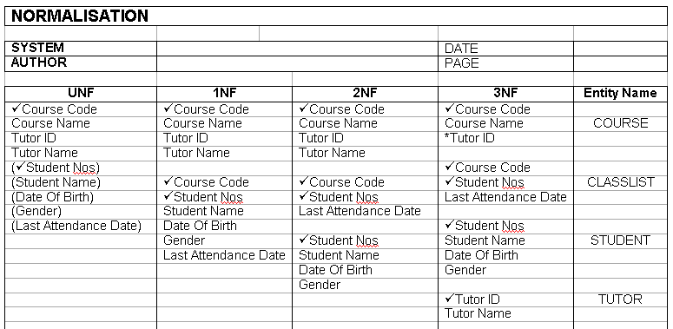
Converting To 3rd Normal Form (3NF)
Example: From Previous Example (INF & 2NF) – Converting to 3NF
Note:
Any entity which has only one non-key attribute is already in 3NF.
In the example above the entity CLASSLIST falls into this category.

Slide 26
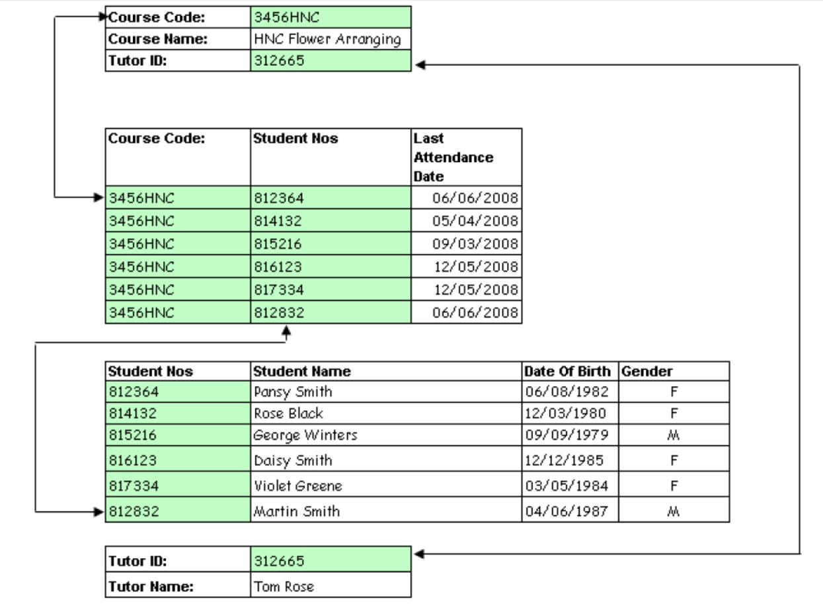
Converting To 3rd Normal Form (3NF)

Slide 27
3rd Normal Form (3NF) – Contd.
Transitive Functional Dependency
Definition: Transitive functional dependency can only occur if there is more than one non-key field, so we can say that a relation in 2NF with zero or one non-key field must automatically be in 3NF.
Note
Transitive functional dependencies arise:
When one non-key attribute is functionally dependent on another non-key attribute
When there is redundancy in the database

Slide 28
3rd Normal Form (3NF) – Example 2
project_no | manager | address |  | Project has more than one non-key field so we must check for transitive dependency:
p1 | Black,B | 32 High Street
p2 | Smith,J | 11 New Street
p3 | Black,B | 32 High Street
p4 | Black,B | 32 High Street

Slide 29
3rd Normal Form (3NF) – Example 2 -Contd.
Extract (from example table)
Address depends on the value of manager.
From the table we can propose:
Project(project_no, manager, address) manager -> address
In this case address is transitively dependent on manager. The primary key is project_no, but the LHS and RHS have no reference to this key, yet both sides are present in the relation.

Slide 30
3rd Normal Form (3NF) – Example 2 -Contd.
Problem (from example table)
Data redundancy results into problems which arise from the following:
We duplicate address if a manager is in charge of more than one project
Causes problems if we had to change the address - have to change several entries, and this could lead to errors.

Slide 31
3rd Normal Form (3NF) – Example 2 -Contd.
How To The Fix Problem (from example table)
Eliminate transitive functional dependency by splitting the table
create two relations - one with the transitive dependency in it, and another for all of the remaining attributes.
split Project into Project and Manager.
The determinant attribute becomes the primary key in the new relation - manager becomes the primary key to the Manager relation
The original key is the primary key to the remaining non-transitive attributes - in this case, project_no remains the key to the new Projects table.

Slide 32
3rd Normal Form (3NF) – Example 2 -Contd.
Results (from example table)
Now we need to store the address only once
If we need to know a manager's address we can look it up in the Manager relation
The manager attribute is the link between the two tables, and in the Projects table it is now a foreign key.
These relations are now in third normal form.
Project | project_no | manager
 | p1 | Black,B
 | p2 | Smith,J
 | p3 | Black,B
 | p4 | Black,B
Manager | manager | address
 | Black,B | 32 High Street
 | Smith,J | 11 New Street

Slide 33
3rd Normal Form (3NF) – Summary
Rule: A relation in 2NF with only one non-key attribute must be in 3NF
In a normalised relation a non-key field must provide a fact about the key, the whole key and nothing but the key.
Relations in 3NF are sufficient for most practical database design problems. However, 3NF does not guarantee that all anomalies have been removed.
Example:
Given
R(a,b,c,d)
c -> d
Becomes
R(a,b,c)
R1(c,d)

Slide 34
Resource - Links
http://www.sqa.org.uk/e-learning/DDFun01CD/page_08.htm
https://www.w3schools.in/dbms/database-normalization/

